Slide 1
Stock Price Prediction using LSTM
By: khandil karimi

Slide 2
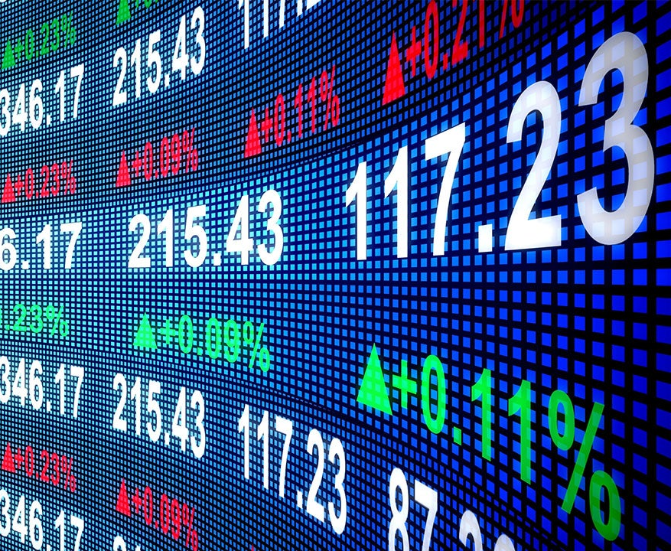
Why I chose this project
Out of the three options (RAG, KRAG, Stock Prediction), this was the most understandable and beginner-friendly
I had prior experience with a similar project using bike data earlier in the semester
The topic is practical and directly connects to real-world financial applications
Stock prediction is something many companies actually try to do using data and AI, so I found it useful and interesting

Slide 3
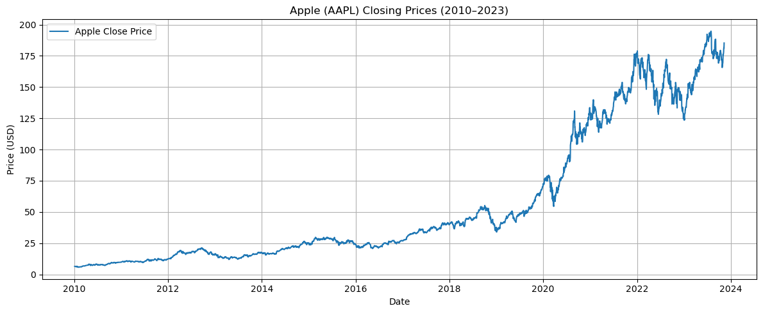
Dataset Overview
13 years of Apple (AAPL) stock data (2010–2023)
Data source: Yahoo Finance via yfinance Python library
Focused only on the “Close” price column for daily price trends
Over 3,400 total data points (trading days)
Used to train the model for time-series forecasting

Slide 4




Tools and Technologies
Python programming language to write and run the code
JupyterLab to organize the workflow and view results step-by-step
yfinance to fetch live historical stock price data (Apple stock, AAPL)
MinMaxScaler from scikit-learn to normalize the data
TensorFlow and Keras to build and train the LSTM model
GitHub to submit my notebook, report, and presentation files

Slide 5
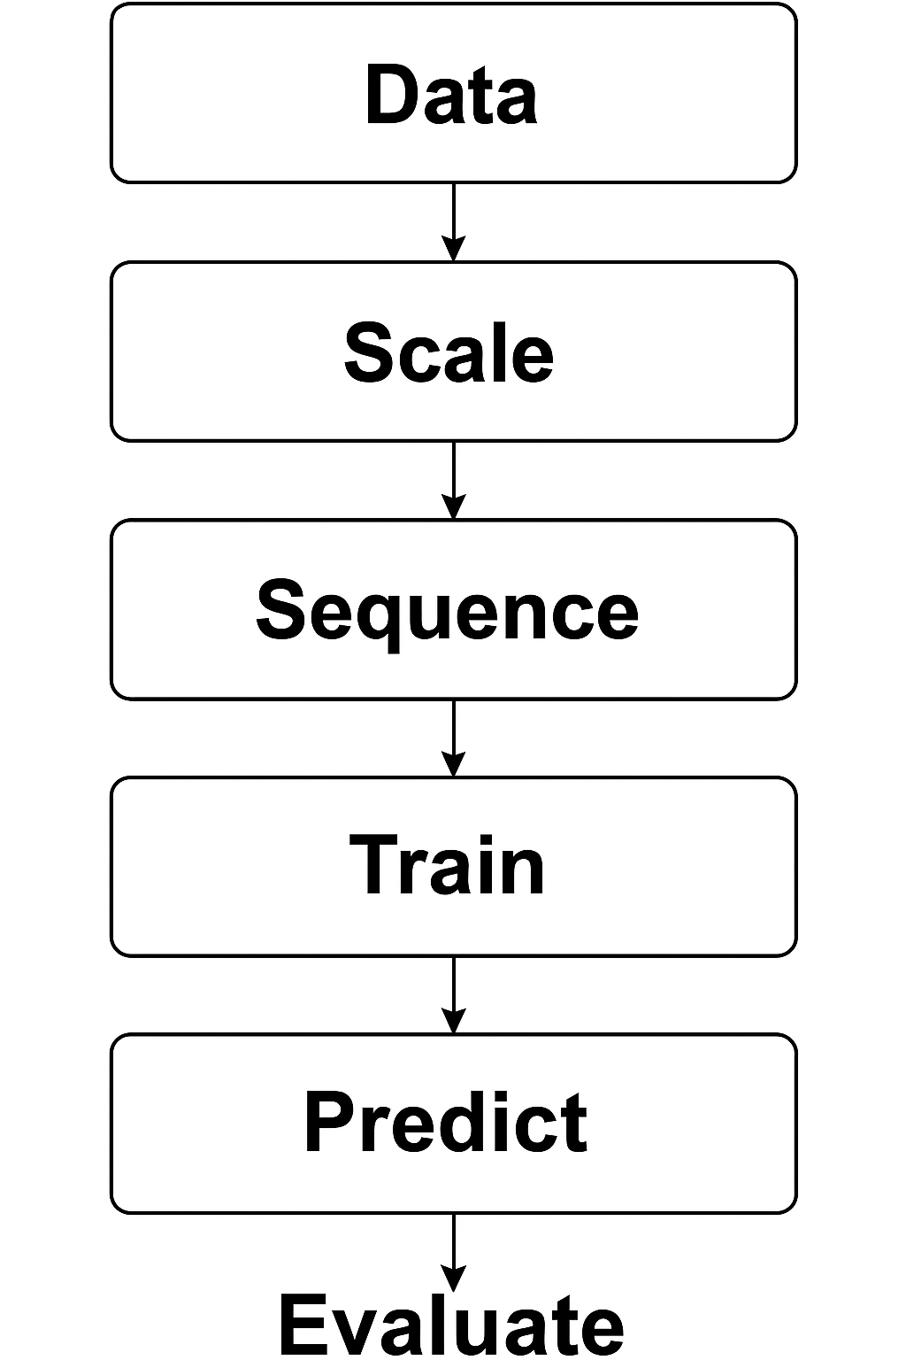
Project Process
Downloaded 13 years of Apple stock closing prices (2010–2023)
Scaled prices to the 0–1 range using MinMaxScaler to help the model train faster
Created 60-day sequences to predict the 61st day's closing price
Split the dataset into 80% training and 20% testing
Built an LSTM model with two LSTM layers and two Dense layers
Trained the model for 5 epochs with a batch size of 32
Used the trained model to predict prices and calculated RMSE for accuracy

Slide 6
Results and RMSE
Final RMSE: approximately 5.74 (Root Mean Square Error)
This means the model was off by around $5.74 per prediction, on average
A low RMSE shows that the model learned meaningful patterns, even in unpredictable stock data
Although it’s not perfect, it’s a solid result for a basic time-series model without extra features

Slide 7
What I Learned
Got comfortable working with real-world data and cleaning/preprocessing it
Learned how LSTMs are designed to handle time-based or sequential data
Gained hands-on experience with TensorFlow, Keras, and model training basics

Slide 8
Final Thoughts
This project allowed me to apply course concepts to a realistic and data-driven problem
It strengthened my understanding of machine learning workflows from start to finish
I walked away with a clearer view of how technical skills translate into practical solutions

